Slide 1
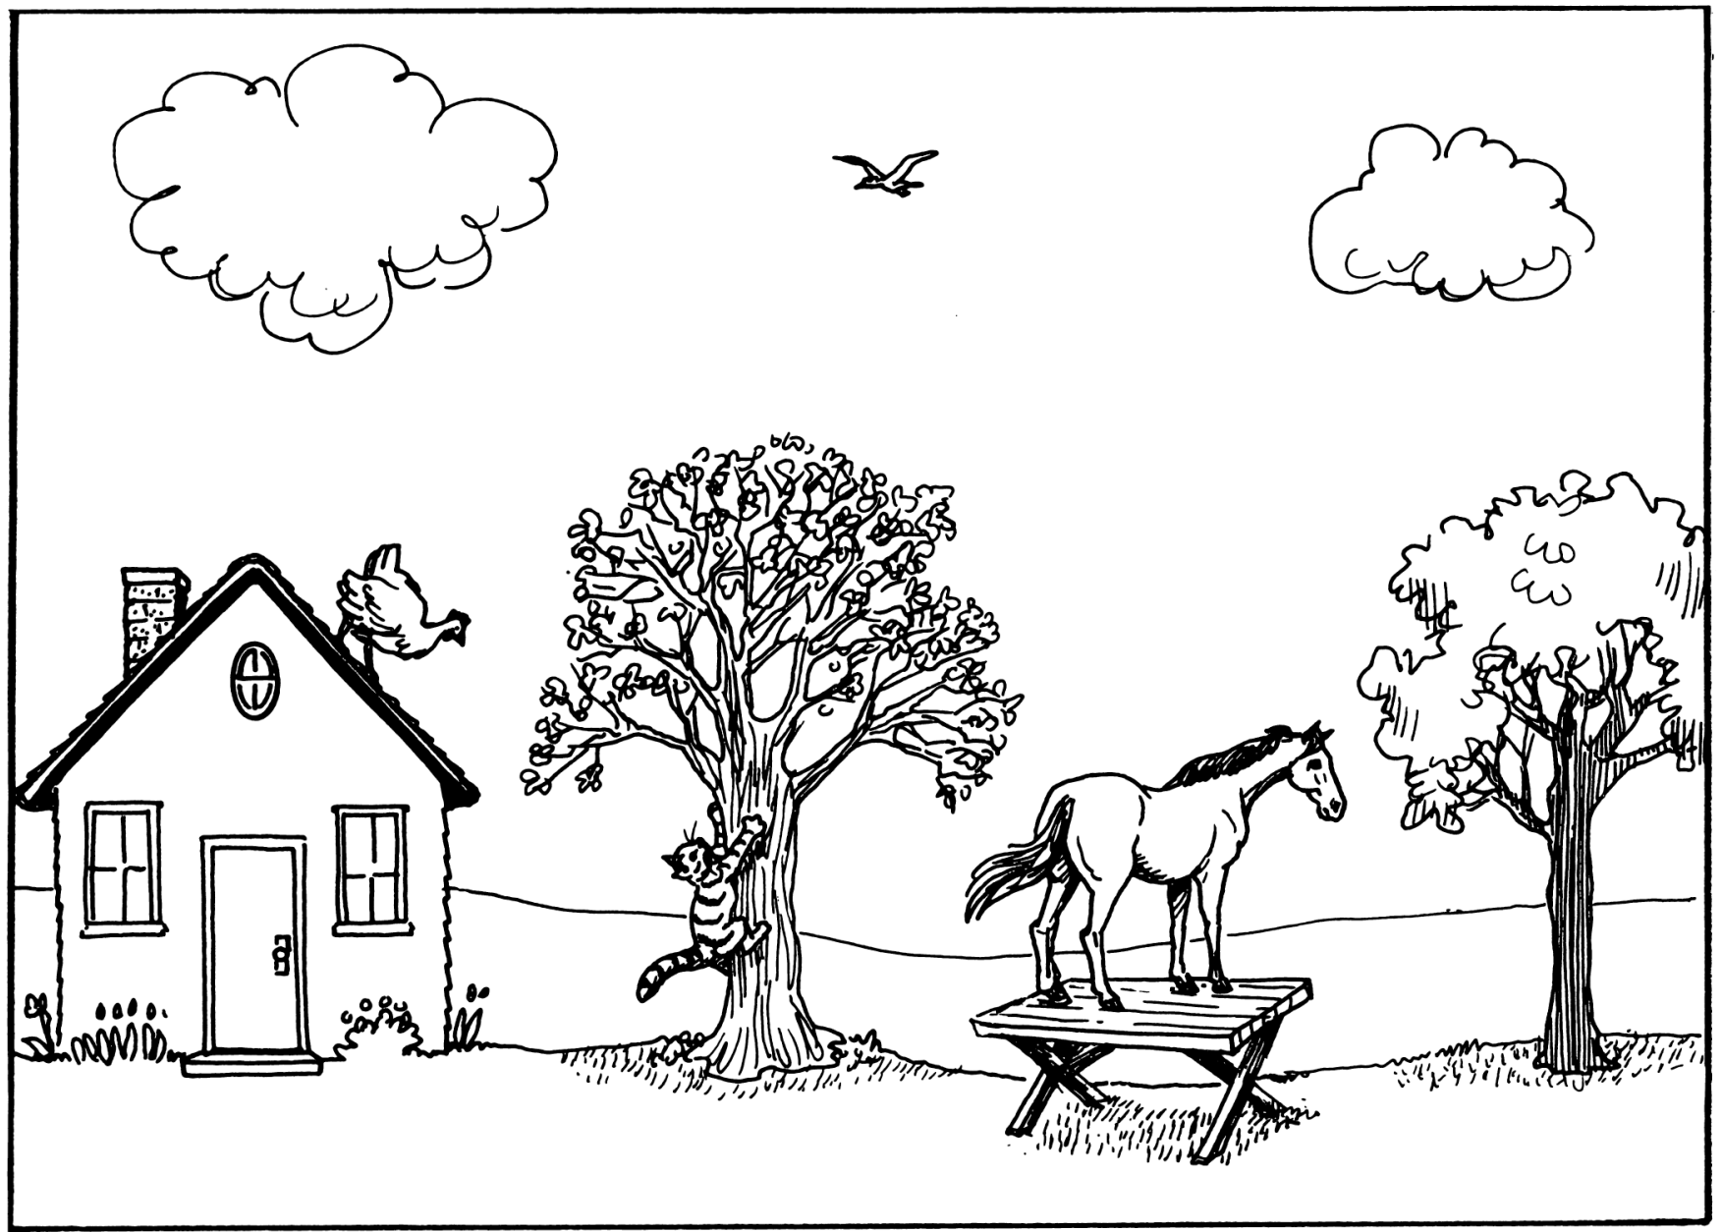
How do we make the most of examples, explanations, and elaborations?
Alex Blanksby @VMN_alex
www.vicmathsnotes.weebly.com

Slide 2
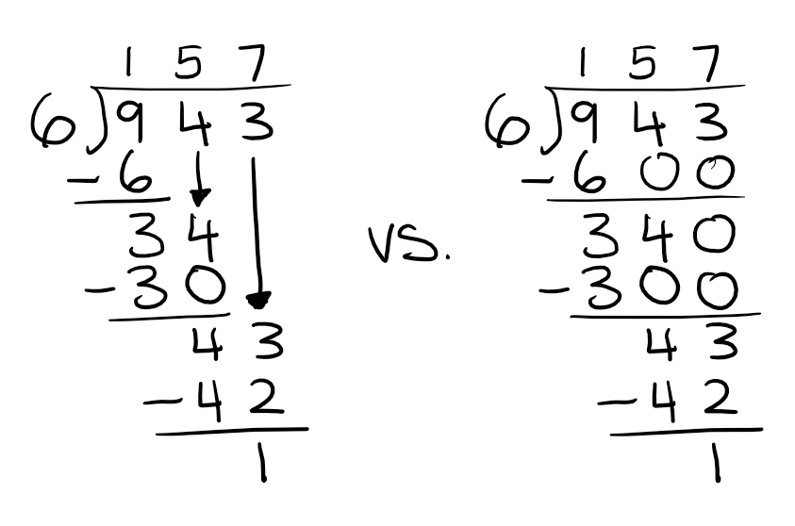
Compare the Pair

Slide 3
Compare the Pair
$$\frac{12}{15}=\frac{12}{15}÷\frac{3}{3}=\frac{4}{5}$$
$$\frac{12}{15}=\frac{12÷3}{15÷3}=\frac{4}{5}$$
$$\frac{12}{15}=\frac{4×3}{3×5}=\frac{4×1}{1×5}=\frac{4}{5}$$
$$\frac{12}{15}=\frac{2×2×3 }{ 3×5}=\frac{2×2×1 }{ 1×5}=\frac{2^{2}}{5}=\frac{4}{5}$$

Slide 4
Compare the Pair
Factorise $x^{2}+13x+30$
Factors of 30
$$1+30=31$$
$$2+15=17$$
$$3+10=13$$
$$5+6=11$$
$$x^{2}+13x+30=\left(x+3\right)\left(x+10\right)$$
Addends of 13
$$0×13=0$$
$$1×12=12$$
$$2×11=22$$
$$3×10=30$$
$$4×9=36$$
$$5×8=40$$
$$6×7=42$$
$$x^{2}+13x+30=\left(x+3\right)\left(x+10\right)$$

Slide 5
Compare the Pair
$$\left[\begin{matrix}\begin{aligned}1 \\ 2 \\ 3\end{aligned} & \begin{aligned}4 \\ 8 \\ 9\end{aligned}\end{matrix}\right]×\left[\begin{aligned}\begin{matrix}5 & 6 & 7 & +8\end{matrix} \\ \begin{matrix}2 & 3 & 1 & −1\end{matrix}\end{aligned}\right]=\left[\begin{matrix}1×5+4×2 & 1×6+4×3 & 1×7+4×1 & 1×8+4×−1 \\ 2×5+8×2 & 2×6+8×3 & 2×7+8×1 & 2×8+8×−1 \\ 3×5+9×2 & 3×6+9×3 & 3×7+9×1 & 3×8+9×−1\end{matrix}\right]$$
$$=\left[\begin{matrix}5+8 & 6+12 & 7+4 & 8−4 \\ 10+16 & 12+24 & 14+8 & 16−8 \\ 15+18 & 18+27 & 21+9 & 24−9\end{matrix}\right]=\left[\begin{matrix}13 & 18 & 11 & 4 \\ 26 & 36 & 22 & 8 \\ 33 & 45 & 30 & 15\end{matrix}\right]$$
$$\begin{aligned}Example \\ \left[\begin{matrix}\begin{aligned}1 \\ 2 \\ 3\end{aligned} & \begin{aligned}4 \\ 8 \\ 9\end{aligned}\end{matrix}\right]×\left[\begin{aligned}\begin{matrix}5 & 6 & 7 & +8\end{matrix} \\ \begin{matrix}2 & 3 & 1 & −1\end{matrix}\end{aligned}\right]\end{aligned}\begin{aligned}a \\ = \end{aligned}\begin{matrix} & \begin{matrix}5 & 6 & 7 & 8\end{matrix} \\ \begin{aligned}1 \\ 2 \\ 3\end{aligned} & \left[\begin{matrix}1×5 & 1×6 & 1×7 & 1×8 \\ 2×5 & 2×6 & 2×7 & 2×8 \\ 3×5 & 3×6 & 3×7 & 3×8\end{matrix}\right]\end{matrix}+\begin{matrix} & \begin{matrix}2 & 3 & 1 & −1\end{matrix} \\ \begin{aligned}4 \\ 8 \\ 9\end{aligned} & \left[\begin{matrix}4×2 & 4×3 & 4×1 & 4×−1 \\ 8×2 & 8×3 & 8×1 & 8×−1 \\ 9×2 & 9×3 & 9×1 & 9×−1\end{matrix}\right]\end{matrix}$$
$$=\left[\begin{matrix}5 & 6 & 7 & 8 \\ 10 & 12 & 14 & 16 \\ 15 & 18 & 21 & 24\end{matrix}\right]+\left[\begin{matrix}8 & 12 & 4 & −4 \\ 16 & 24 & 8 & −8 \\ 18 & 27 & 9 & −9\end{matrix}\right]=\left[\begin{matrix}13 & 18 & 11 & 4 \\ 26 & 36 & 22 & 8 \\ 33 & 45 & 30 & 15\end{matrix}\right]$$

Slide 6
Alternate Methods
Obviously if the first explanation you try doesn’t help a student, then you do need to try another one – I never want people to stop providing alternatives!
But perhaps the explanation you use as the standard one doesn’t have to be the standard. Perhaps the other one you usually save for second might work as the first explanation for all the people the standard one works for, and also a few more. Each new explanation needs a bit of consideration to decide if maybe it can supplant the one you usually use first. At the very least, when you hear or think of an alternative explanation, don’t say, “I will keep that in mind for my struggling kids.”
Even better, perhaps we should more often just provide more than one explanation to begin with, rather than just one. No explanation can possibly work for all possible students, and even the “smart kids” will benefit from having more than one way to think about something. So maybe we can avoid othering people by simply giving more options from the outset. For example, to stop students feeling like they’re a “dumb kid” when you draw pictures, you can just draw pictures for everyone a lot more of the time.
David Butler @DavidButlerUoA - Other(ing) Explanations

Slide 7
Directions of Travel
familiar → unfamiliar | use what is familiar to students to introduce what is unfamiliar
concrete → abstract | use tangible objects to introduce intangible concepts
wood → trees → wood | bookend the details with the broader idea
simple → complex | introduce complexity over time
explanation → definition | explain an idea then give its definition (rather than the opposite)
example → principle → example | bookend a concept that explains examples with examples the concept explains
hinterland → core | use non-prescribed stories/contexts to motivate the prescribed content
conflict → resolution | use narrative conflict to segue into what resolves the conflict
Adam Boxer @adamboxer1 - Teaching Secondary Science

Slide 8
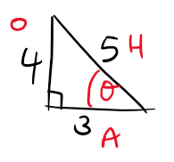
familiar → unfamiliar
$$\sin\left(θ\right)=\frac{O}{H}=\frac{4}{5}$$
$$\cos\left(θ\right)=\frac{A}{H}=\frac{3}{5}$$
$$\tan\left(θ\right)=\frac{O}{A}=\frac{4}{3}$$

Slide 9
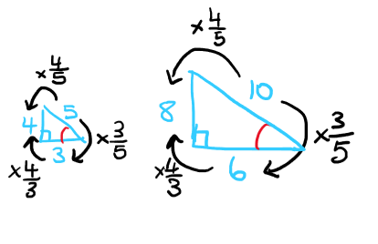
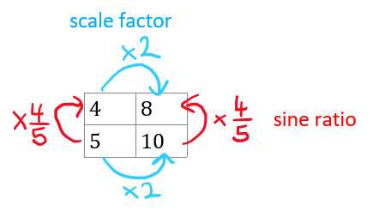
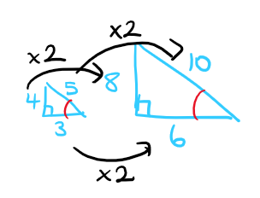
familiar → unfamiliar

Slide 10
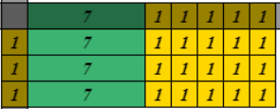
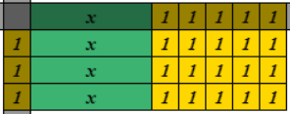
familiar → unfamiliar
Expand $3×\left(7+5\right)$
$$=\left(7+5\right)+\left(7+5\right)+\left(7+5\right) \\ =\left(3×7\right)+\left(3×5\right) \\ =21+15$$
Expand $3×\left(x+5\right)$
$$=\left(x+5\right)+\left(x+5\right)+\left(x+5\right) \\ =\left(3×x\right)+\left(3×5\right) \\ =3x+15$$

Slide 11
familiar → unfamiliar
use what is familiar to students to introduce what is unfamiliar
meet students where they are (in terms of their knowledge) and take them from there
co-opt students’ knowledge to assimilate and integrate new knowledge
even more critical in hierarchical subjects (avoids disconnected ideas)
Adam Boxer @adamboxer1 - Teaching Secondary Science

Slide 12
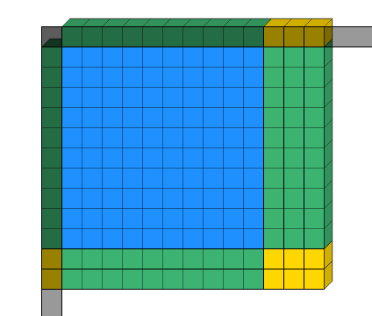
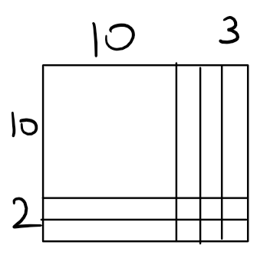
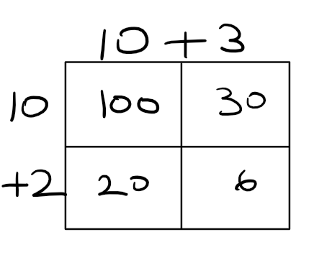
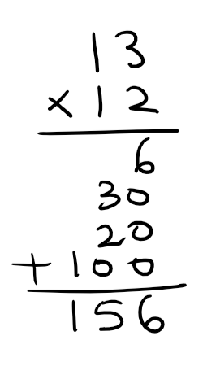
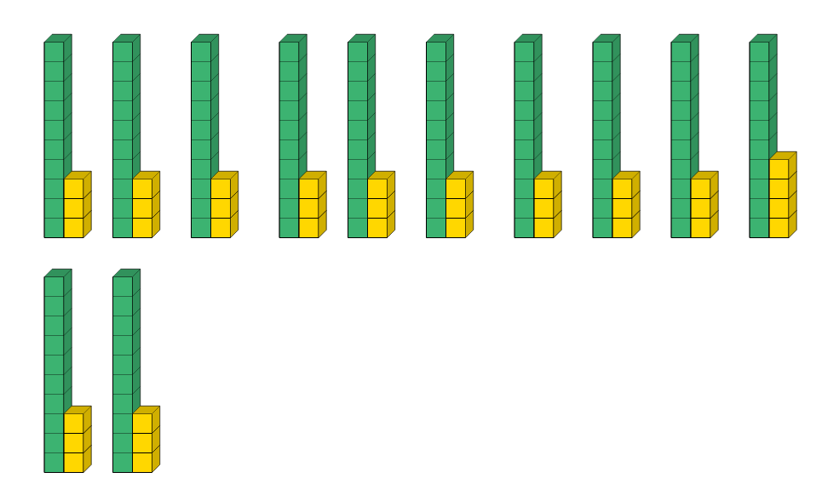
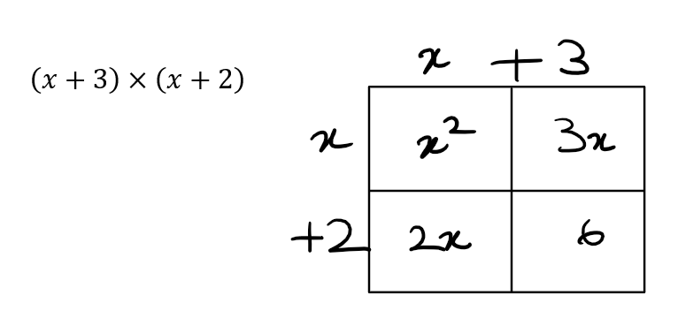
concrete → abstract
$$13×12$$

Slide 13
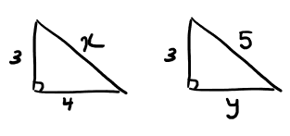
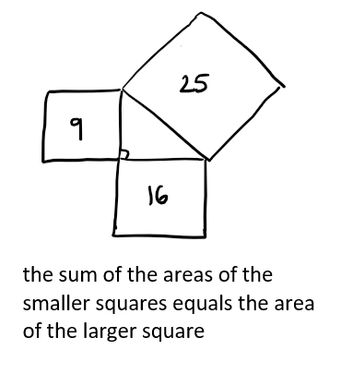
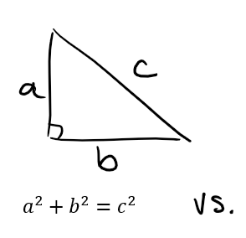
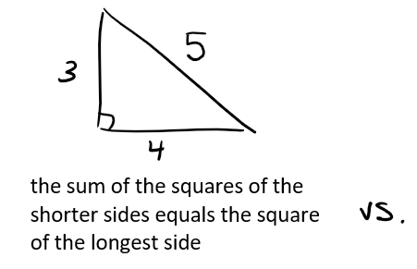
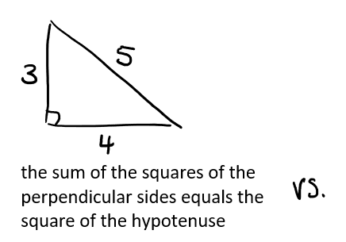
concrete → abstract

Slide 14
concrete → abstract
use tangible objects to introduce intangible concepts
in maths we consider "concrete, pictorial, abstract (CPA)" not as a sequence but to keep returning to each boosting connections
when introducing a new formula, start with a worded version and numerical calculations, then bring in the algebraic form
Adam Boxer @adamboxer1 - Teaching Secondary Science

Slide 15
conflict → resolution
Evaluate the expression below where $x=5$
$3x+9x−24x−2x+15x+8x−4x−21x+39x−23x$
$=3x+9x+15x+8x+39x−24x−2x−4x−21x−23x$
$=74x−74x$
$=0x$

Slide 16
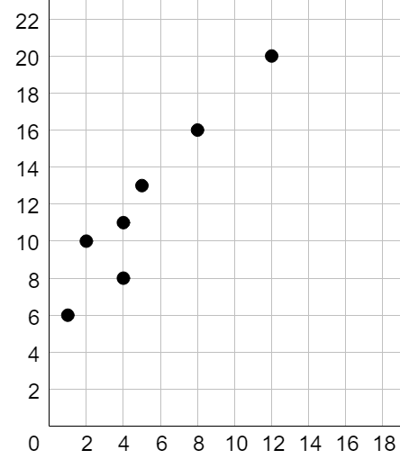
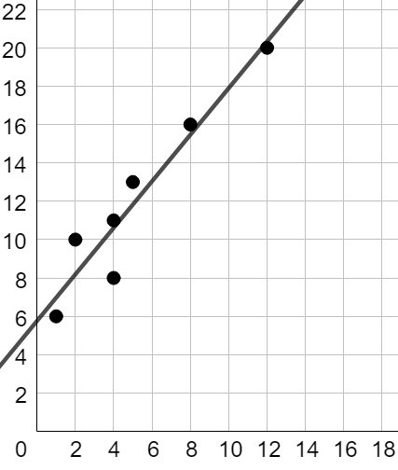
conflict → resolution
Use the data below to predict the value of $y$ when $x=10$
$$x$$ | $$1$$ | $$2$$ | $$4$$ | $$4$$ | $$5$$ | $$8$$ | $$12$$
$$y$$ | $$6$$ | $$10$$ | $$11$$ | $$8$$ | $$13$$ | $$16$$ | $$20$$

Slide 17
conflict → resolution
use narrative conflict ("some mystery that lies at the heart of what you are trying to achieve") to segue into what resolves the conflict
similar to Dan Meyer's headache-aspirin: motivates the need for the new idea (aspirin) to solve the problem (headache)
what broad question is your lesson/concept trying to answer? use that as your learning intention
useful for introducing terminology and symbols/shorthand, conventions, and methods that simplify tedious things
Adam Boxer @adamboxer1 - Teaching Secondary Science

Slide 18
Scripting and Honing Explanations
get to the point
longer explanations make content feel more complex (break it up where reasonable)
find places to minimise/combine steps in a process
show live worked solutions in real time (don't digress)
what is the bare minimum you can teach for students to be able to answer a related question?
alternate example and practice rather than all examples then all practice
provide the notes/examples so more time is spent actively thinking not passively copying

Slide 19
Scripting and Honing Explanations
script your explanations and examples
a script is not a second-to-second run down of a lesson
a lesson can be several scripts you bounce between
writing a script refines your explanation
when internalised, a script reduces your cognitive load
a script written by a more expert teacher is scaffold for early career and out-of-field teachers
a script is not fixed (it can and should be improved)

Slide 20
Scripting and Honing Explanations
Wording Principle
To make the sequence of examples as clear as possible, use the same wording on juxtaposed examples (or wording that is as similar as possible).
Fact Wording
Avoid: “If it is not __A__, then it is __2__.”
Prefer: “If it is __1__, then it is __2__.”
Engelmann & Carnine - Theory of Instruction

Slide 21
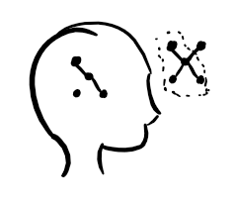
What are students thinking about?
Memory is the residue of thought.
We remember the aspect of it that we think about.
How do we ensure students are thinking about the things that will help them learn?
Prompt them to explain and elaborate.
Why Don't Students Like School - Daniel Willingham

Slide 22
Worked Example with Prompts
Karen Hancock @karenshancock

Slide 23
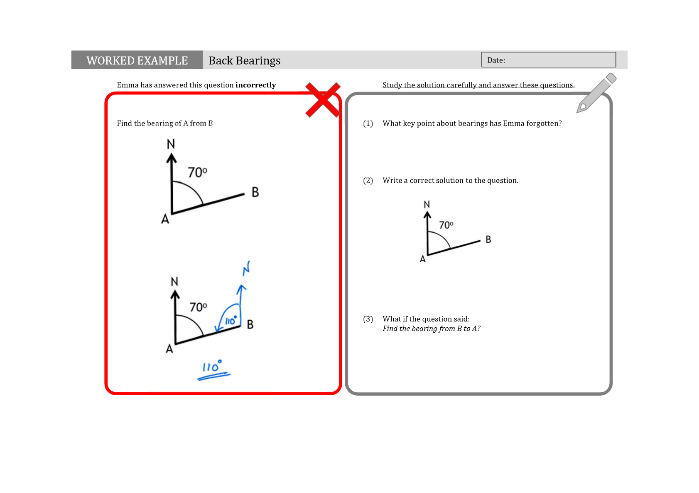
Worked Example with Prompts
Karen Hancock @karenshancock

Slide 24
Principle-based Self-explanations
principle-based self explanations: relating a step in a worked solution or feature of an object to an underlying principle
greatest benefits:
early in learning process
connects example to general principles
improve student explanations by:
giving time for students to read, think about, and notice features of the example
prompting pre-requisite knowledge
show what a good explanation looks like (because, but, so)
scaffold explanations using
menu of reasonable explanations
build from sequential choices of options
fill in the blanks
Michael Pershan @mpershan - Teaching Math with Examples

Slide 25
Principle-based Self-explanations
avoid asking 'what' questions...focus on asking 'why' questions
Push students to think harder by asking them to explain "why" and "what if" questions.
"What did [x] do as his first step?"
"Would it have been OK to write __________? Why or why not?"
Why did [x] combine ______ and ________?"
"Would [x] have gotten the same answer if they _______ first?"
"Explain why _______ would have been an unreasonable answer?"
"[x] answered this question incorrectly. Explain what they have done wrong. Correct their mistake and find the correct answer. Now try this question." (question should be similar)
"Which parts of the solution will look different, and which will remain the same?"
target common misconceptions and calculator mistakes
"Which of the following best explains why _______ is true?" (all options should be reasonable in the context)
"[x] used a different method and got the same answer. Explain why their method works. Explain which would be preferred for this example? What about this example?"
"What is similar/different about _________ compared to the example?"
Michael Pershan @mpershan - Teaching Math with Examples

Slide 26
Questions and Prompts for Mathematical Thinking
Exemplifying, Specialising Give me one or more examples of … Describe, Demonstrate, Tell, Show, Choose, Draw, Find, Locate, an example of … Is … an example of …? What makes … an example? Find a counter-example of … Are there any special examples of …? Completing, Deleting, Correcting What must be $\left\{\begin{aligned}added \\ removed \\ altered\end{aligned}\right\}$ in order to $\left\{\begin{aligned}allow \\ ensure \\ contradict\end{aligned}\right\}$ …? What can be $\left\{\begin{aligned}added \\ removed \\ altered\end{aligned}\right\}$ without affecting …? Tell me what is wrong with … What needs to be changed so that …? Comparing, Sorting, Organising What is the same and different about …? Sort or organise the following according to … Is it or is it not …? | Changing, Varying, Reversing, Altering Alter an aspect of something to see effect. What if …? If this is the answer to a similar question, what was the question? Do … in two (or more) ways. What is quickest, easiest, …? Change … in response to imposed constraints. Generalising, Conjecturing Of what is this a special case? What happens in general? Is it always, sometimes, never …? Describe all possible … as succinctly as you can. What can change and what has to stay the same so that … is still true? Explaining, Justifying, Verifying, Convincing, Refuting Explain why … Give a reason … (using or not using …) How can we be sure that …? Tell me what is wrong with … Is it ever false that … (always true that …?) How is … used in …? Explain role or use of … Convince me that …
Watson & Mason - Questions and Prompts for Mathematical Thinking

Slide 27
Interrogative elaboration
Asking 'Why?' / 'Why do you think that?' / 'Why do you think that's the answer?"
a way to interrogate more about what a student knows and thinks
needs to be asked enough with both correct and incorrect answers that students do not assume their answer is always wrong when you ask 'why?'
can ease their minds by telling them their answer is correct/incorrect or what the correct answer is and then ask 'why is this correct?' or 'why is this incorrect?'
consider the timing, asking why can break the flow which makes it hard to pick back up (good if a student is doing well, not good if a student is struggling)

Slide 28
Interrogative elaboration
If a student is struggling with a question
What can you tell me about this question?
Tell me where you can get up to.
Do you need me to clarify anything from the question?
Is there anything in the question that you don't know what it means?
Give a choice of options for the next step / for the answer.
Ask why they chose it (regardless of correct or incorrect).
If they struggle to give a reason, tell them whether they are correct or not and ask why the correct answer is correct.
Can also follow up with why their incorrect answer was incorrect.
Do not accept "because the other answer was right".
Do not let them get away with not thinking about the question.

Slide 29
Interrogative elaboration
Pick your battles.
Don't force a student who clearly doesn't follow your questioning to keep enduring it.
Provide or direct to a worked example.
Walk them through the question then provide a similar question with different numbers.
Focus on getting understanding then rapid practice to reinforce
More novice students: direct to the incorrect part of their working, ask why it's wrong / how they can correct it
More expert students: identify the number of mistakes they need to correct but not where they are

Slide 30
Elaborations
Atkinson, Derry, Renkl, Wortham - Learning from Examples: Instructional Principles from the Worked Examples

Slide 31
Regularity in Student Learning Rate
percentile | starting accuracy | median number of opportunities to 80% mastery
25th | 55% | 13.13
50th | 65% | 7.24
75th | 75% | 3.66
$×3$ opportunities!
“the typical student is starting practice well below mastery despite having been provided with verbal instruction in the form of readings and lectures prior to the deliberate practice experiences in our data.”
"The median overall learning rate across datasets … converts to a 2.5 percentage point increase for one practice opportunity from the median intercept of 65%"
Koedinger, Carvalho, Liu, and McLaughlin - An astonishing regularity in student learning rate

Slide 32
Regularity in Student Learning Rate
Compare this to grouping students by learning rate (as opposed to initial knowledge)
25th percentile (slower), 7.89 opportunities
50th percentile (typical), 7.27 opportunities
75th percentile (faster), 6.94 opportunities
That is, "a typical slower learner needs only one extra opportunity to keep pace with a typical faster learner."
*log scale
Koedinger, Carvalho, Liu, and McLaughlin - An astonishing regularity in student learning rate

Slide 33
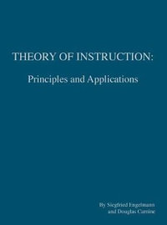
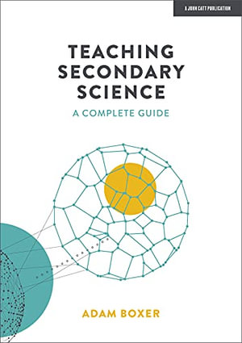
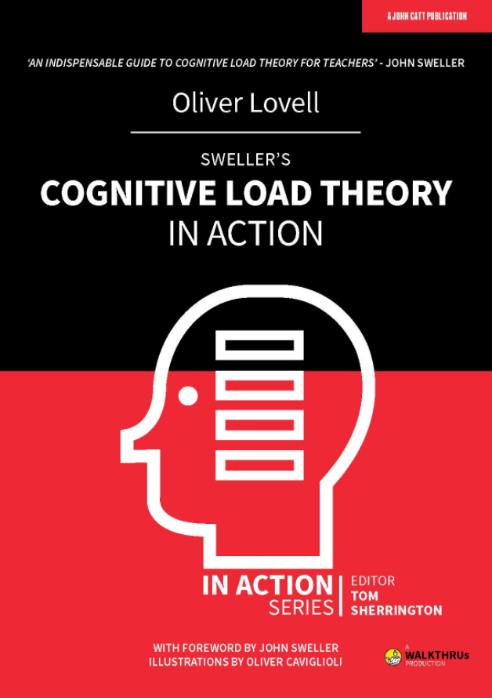
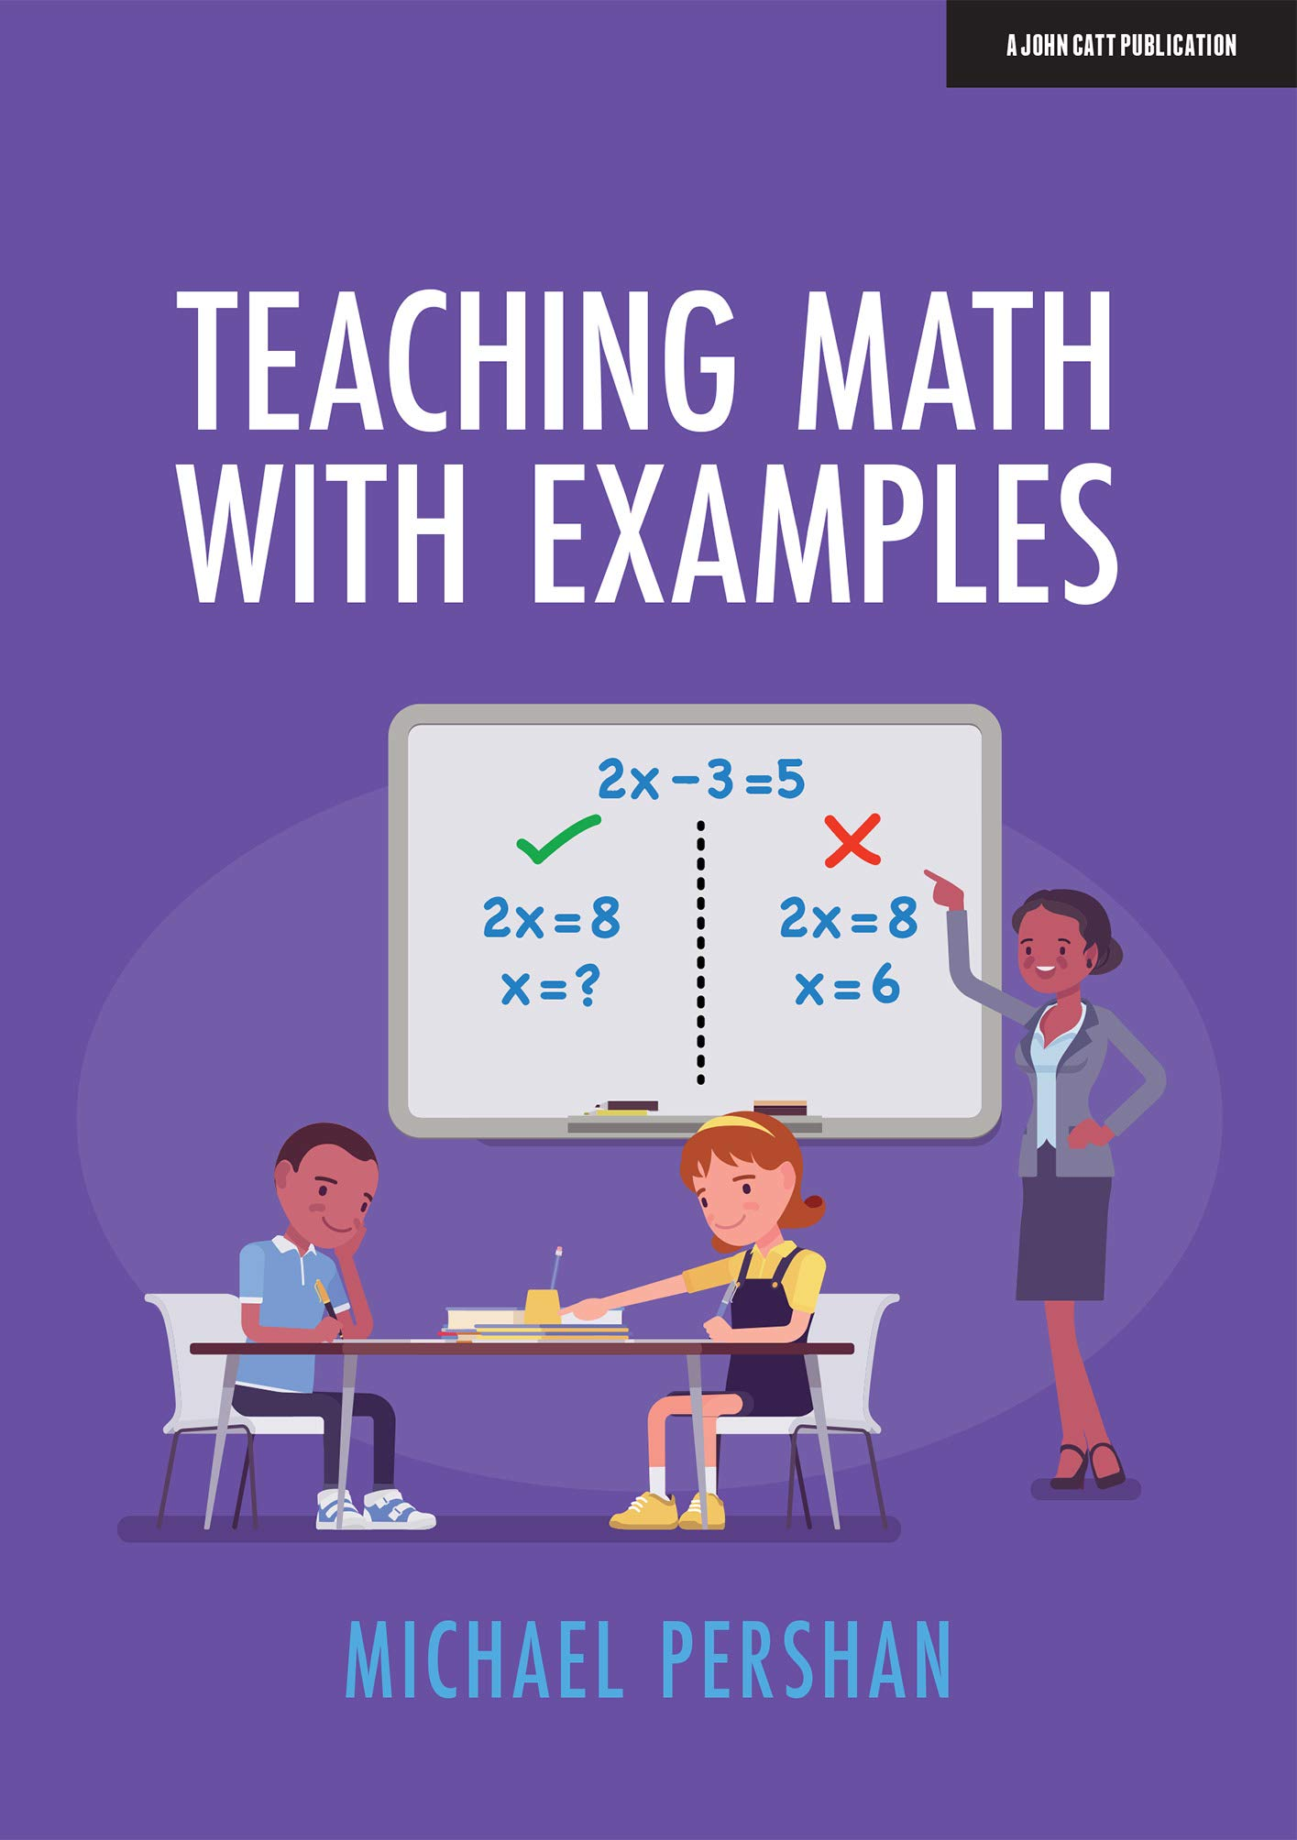
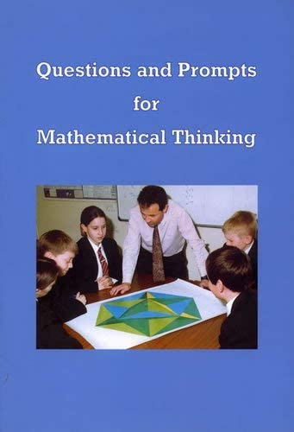
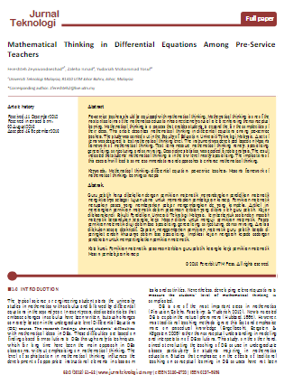
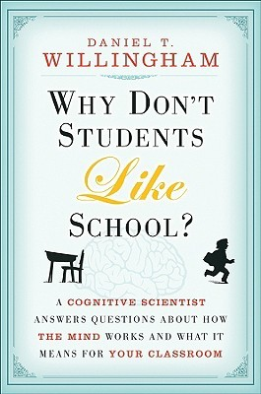
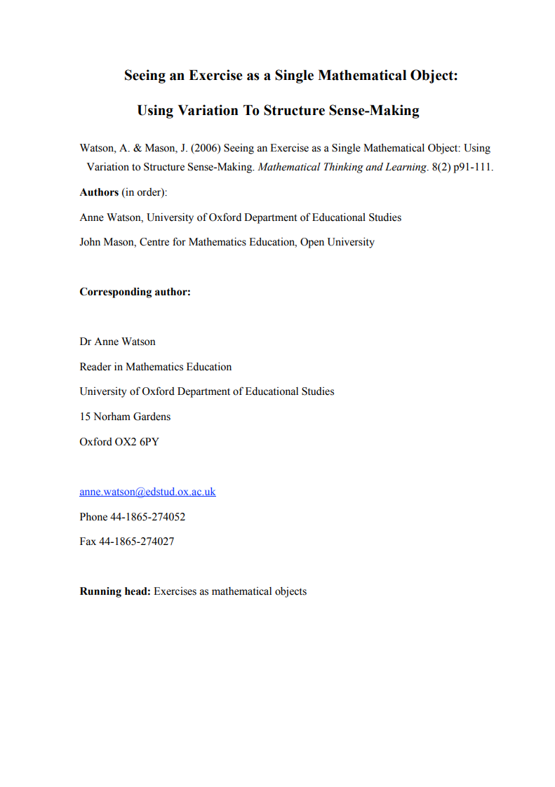
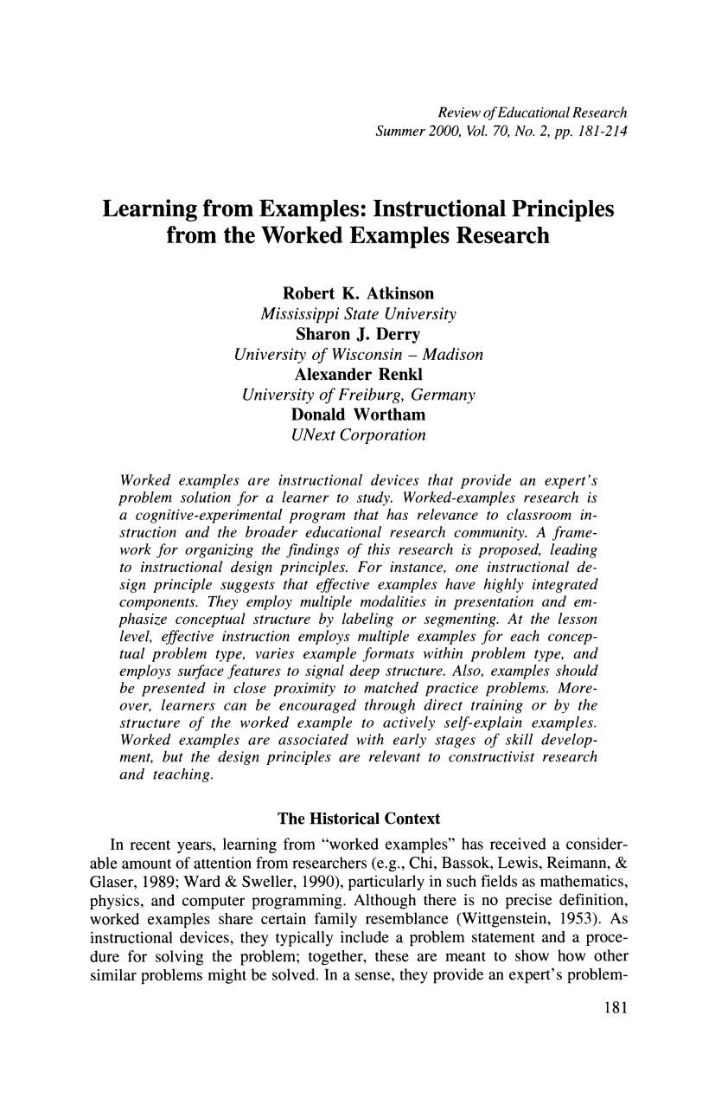
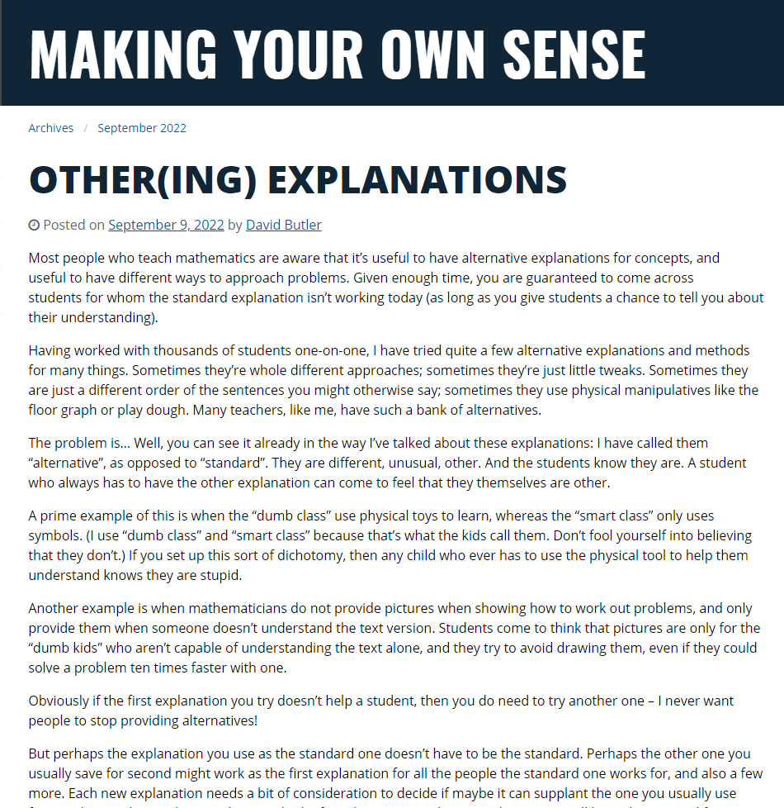
Engelmann, Siegfried, and Carnine, Douglas. Theory of instruction: principles and applications. New York, Irvington Publishers, 1982. |  | Boxer, Adam. Teaching Secondary Science: a Complete Guide. United Kingdom, John Catt Educational, Limited, 2021.
Lovell, Oliver. Sweller's Cognitive Load Theory in Action. United Kingdom, John Catt Educational Limited, 2020. |  | Pershan, Michael. Teaching Math with Examples. United Kingdom, John Catt Educational, Limited, 2021.
Watson, Anne, and Mason, John. Questions and Prompts for Mathematical Thinking. United Kingdom, Association of Teachers of Mathematics, 1998. |  | Zeynivandnezhad, Fereshteh & Ismail, Zaleha & Yosuf, Yudariah. (2013). Mathematical Thinking in Differential Equations Among Pre-Service Teachers. Jurnal Teknologi. 63. 10.11113/jt.v63.2009.
Willingham, Daniel T.. Why Don't Students Like School? A Cognitive Scientist Answers Questions About How the Mind Works and What It Means for the Classroom. Germany, Wiley, 2009. |  | Watson, A. & Mason, J. (2006) Seeing an Exercise as a Single Mathematical Object: Using Variation to Structure Sense-Making. Mathematical Thinking and Learning. 8(2) pp.91-111
Butler, David. Other(ing) Explanations. Making Your Own Sense, 2022 available at https://blogs.adelaide.edu.au/maths-learning/2022/09/09/othering-explanations/ |  | Learning from Examples: Instructional Principles from the Worked Examples Research Author(s): Robert K. Atkinson, Sharon J. Derry, Alexander Renkl, Donald Wortham
Koedinger, K.R., Carvalho, P.F., Liu, R. and McLaughlin, E.A. (2023). An astonishing regularity in student learning rate. Proceedings of the National Academy of Sciences, 120(13). doi:https://doi.org/10.1073/pnas.2221311120.

Slide 34
Alex Blanksby @VMN_alex
www.vicmathsnotes.weebly.com
Thanks for coming!

